Slide 1

Candidate shortlist
Chief Operating Officer
In this shortlist
Eleanor Marsh · Group Operations Director, Marlow & Reeve Logistics
Daniel Okafor · Chief Operating Officer, Stratton Rail Freight
Sofia Lindqvist · VP Supply Chain, Europe, Corran Foods plc
Prepared for
Halden Group
September 2026 · Strictly confidential
Template by Formatix.AI — formatix.ai/templates

Slide 2

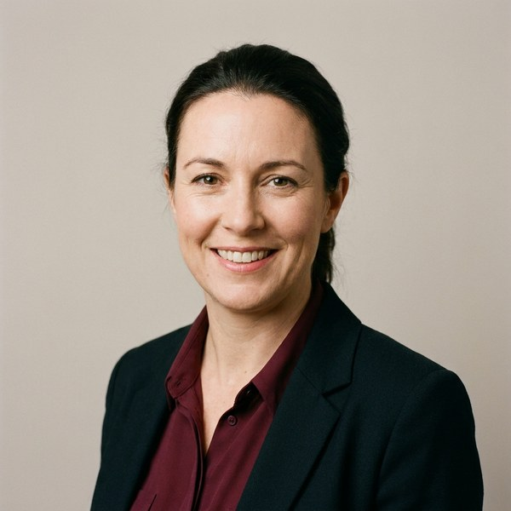
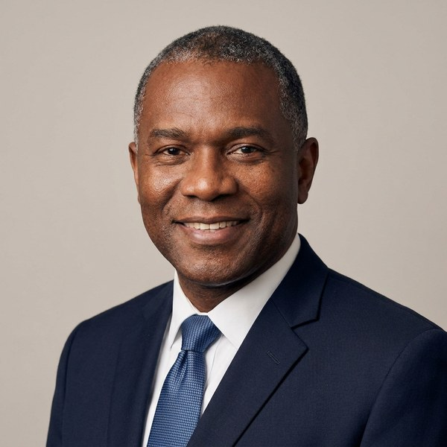
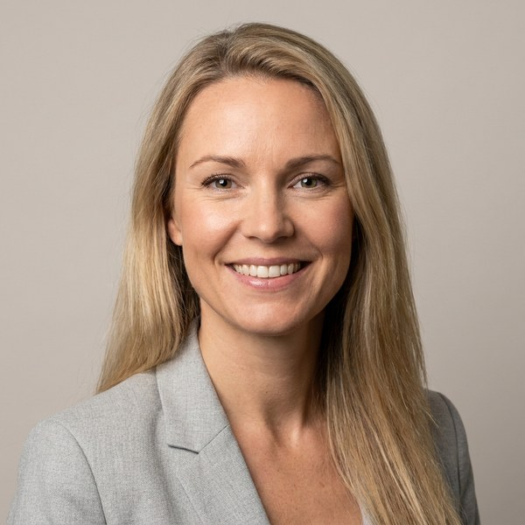
Halden Group · Chief Operating Officer · Confidential
Shortlist comparison
The candidates, side by side
Eleanor Marsh
Daniel Okafor
Sofia Lindqvist
Group Operations Director
Chief Operating Officer
VP Supply Chain, Europe
Marlow & Reeve Logistics · Leeds, UK
Stratton Rail Freight · Birmingham, UK
Corran Foods plc · Amsterdam, NL
Scale
Scale
Scale
£640m P&L · 3,200 people · 14 sites
£410m revenue · 2,100 people · UK & EU
€900m spend · 1,400 people · 9 countries
Why they stand out
Why they stand out
Why they stand out
Two post-M&A integrations with no service loss
£38m automation programme; OTIF up to 98.4%
Built a bench of six site leaders
Already a COO; sits on the executive board
Led the £120m network modernisation
Strong customer and tender experience
Listed-company experience across nine markets
Delivered €55m of procurement savings
Fluent Swedish, English and Dutch
Fit against the brief
Fit against the brief
Fit against the brief
■■■■■
■■■■■
■■■■■
■■■■
■■■■■
Operational scale
5/5
Operational scale
4/5
Operational scale
■■■■
4/5
■■■■■
■■■■■
■■■■■
■■■■
■■■■■
Transformation
5/5
Transformation
4/5
Transformation
■■■
3/5
■■■■■
■■■
■■■■■
■■■■■
■■■■■
Commercial breadth
3/5
Commercial breadth
5/5
Commercial breadth
■■■■
4/5
■■■■■
■■■
■■■■■
■■■■
■■■■■
Board readiness
3/5
Board readiness
4/5
Board readiness
■■
2/5
Ready now
Notice 3 months
£240k–£270k base
Ready now
Notice 6 months
£260k–£290k base
Ready in 1-2 years
Notice 3 months
€250k–€280k base
Fit ratings are the consultant’s assessment against the agreed brief. · Template by Formatix.AI — formatix.ai/templates
‹#›

