Slide 1

Candidate bios
Chief Operating Officer
In this selection
Eleanor Marsh · Group Operations Director, Marlow & Reeve Logistics
Daniel Okafor · Chief Operating Officer, Stratton Rail Freight
Sofia Lindqvist · VP Supply Chain, Europe, Corran Foods plc
Prepared for
Halden Group
September 2026 · Strictly confidential
Template by Formatix.AI — formatix.ai/templates

Slide 2

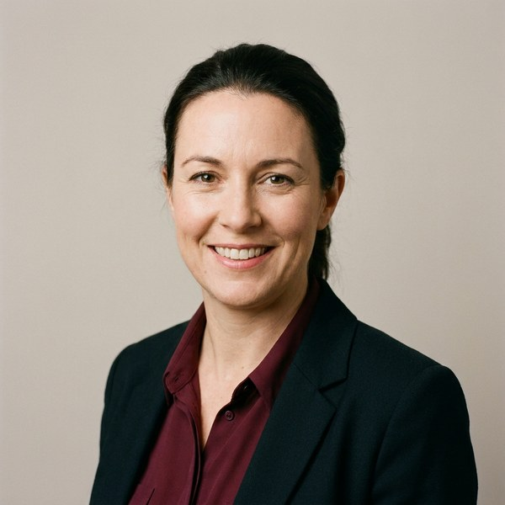
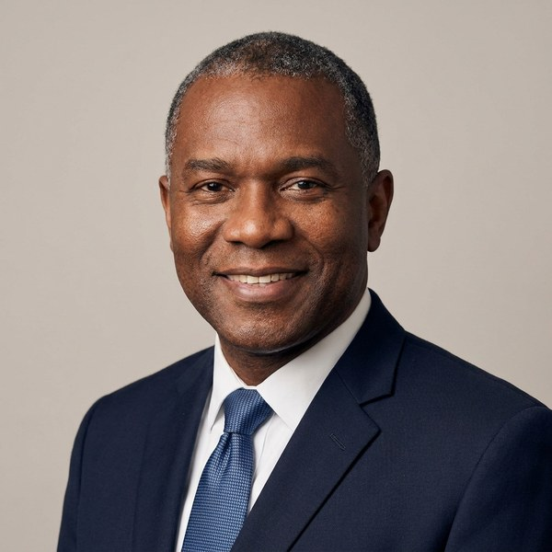
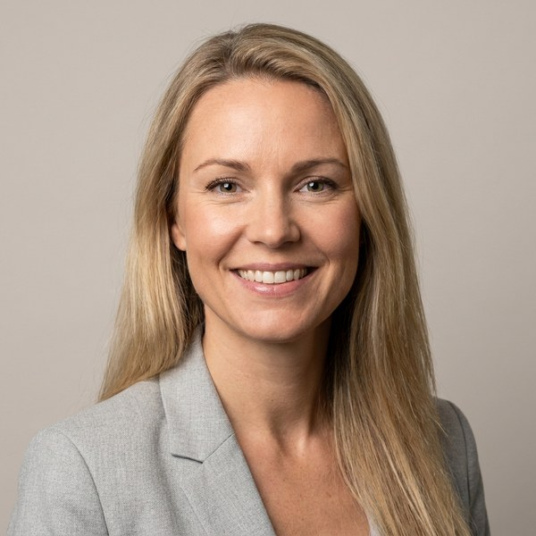
Halden Group · Confidential
Candidate bios
The candidates in brief
Marlow & Reeve Logistics
Stratton Rail Freight
Corran Foods plc
Group Operations Director
Chief Operating Officer
VP Supply Chain, Europe
Eleanor Marsh
Daniel Okafor
Sofia Lindqvist
Group Operations Director · Logistics transformation, automation and post-M&A integration
Chief Operating Officer · Rail and freight networks, customer operations and large capital programmes
VP Supply Chain, Europe · Procurement, S&OP and multi-country operations in listed consumer goods
Leeds, UK
Birmingham, UK
Amsterdam, NL
About
About
About
Eleanor runs operations for a £640m logistics group with 3,200 people across 14 sites. She has led two post-M&A integrations without service loss and a £38m automation programme that lifted on-time delivery to 98.4%. She is known for building strong site leadership teams and for calm, data-led decisions.
Daniel is COO of Stratton Rail Freight, a £410m business with 2,100 people across the UK and EU, and sits on its executive board. He led the £120m network modernisation and rebuilt the tender process, winning three national contracts. Earlier he held commercial and operational roles in port logistics.
Sofia leads supply chain for Corran Foods across nine European markets, with €900m of annual spend and 1,400 people. She delivered €55m of procurement savings in three years and led the carve-out of the chilled division. She is fluent in Swedish, English and Dutch and has worked in three countries.
Previous roles
Previous roles
Previous roles
Operations Director, Kestrel Freight (2016–2020)
Head of Planning, Kestrel Freight (2012–2016)
Operations Manager, Harrow Parcels (2008–2012)
Operations Director, Stratton Rail (2017–2021)
Commercial Director, Portway Terminals (2013–17)
Head of Customer Ops, Portway Terminals (2009–13)
Procurement Director, Corran Foods plc (2018–2022)
Supply Chain Director, Nordvik Brands (2014–18)
Senior Manager, Fenwick Hart Consulting (2010–14)
Education
Education
Education
MBA, Warwick Business School (2015)
BEng Mechanical Engineering, Sheffield (2004)
MSc Transport Economics, University of Leeds (2006)
BA Geography, University of Nottingham (2004)
MSc Supply Chain Management, Erasmus (2009)
BSc Industrial Engineering, KTH Stockholm (2007)
Drawn from each candidate’s CV and our conversations with them · Template by Formatix.AI — formatix.ai/templates
‹#›

