Slide 1

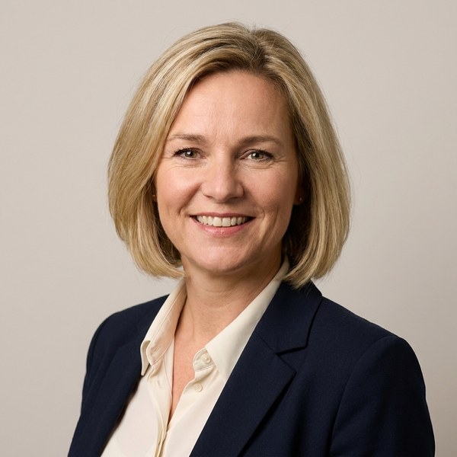
Candidate profile
Proposed for Managing Director, UK & Ireland
Helena Vos
Chief Commercial Officer
Brightwell & Co
A commercial leader who has grown a £180m interiors business by a third and opened two new markets.
Key experience
Education
Location
Amsterdam, Netherlands
Leads sales, marketing and key accounts across nine countries, a team of 140
Grew revenue from £135m to £180m in three years through new sectors
Opened the Irish and German markets, now 22% of group revenue
Led the commercial integration of two acquisitions in Research & Development services
Board member of the Dutch interiors trade association since 2023
MBA, Rotterdam School of Management
MSc Business Economics, University of Amsterdam
Notice period
3 months
Recent roles
Package
Chief Commercial Officer
€210k base + 30% bonus
Brightwell & Co 2022 – Present
Languages
Commercial Director, Europe
English, Dutch, German
Calder & Finch Group 2017 – 2022
Head of Key Accounts
Tolland Marine & Energy 2012 – 2017
Confidential · Template by Formatix.AI — formatix.ai/templates
‹#›

Slide 2
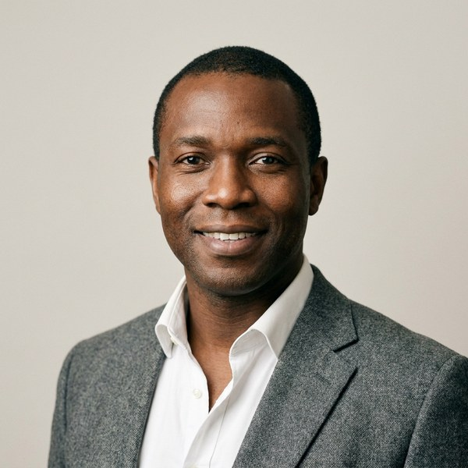
Candidate profile
Proposed for Managing Director, UK & Ireland
Marcus Oyelaran
Managing Director, Ireland
Stratton Rail & Freight
A managing director with full P&L ownership of a €95m freight business and a record of turnaround.
Key experience
Education
Location
Dublin, Ireland
Full P&L for a €95m business with 600 people across four depots
Returned the Irish business to profit within eighteen months
Won the group's largest contract, worth €31m over five years
Introduced a safety programme that halved lost-time injuries
BComm, University College Dublin
Chartered Member, CILT
Notice period
6 months
Recent roles
Experience
Managing Director, Ireland
20 years in logistics
Stratton Rail & Freight 2020 – Present
Operations Director
Stratton Rail & Freight 2015 – 2020
General Manager
Marlow & Reeve Logistics 2009 – 2015
Confidential · Template by Formatix.AI — formatix.ai/templates
‹#›

Slide 3
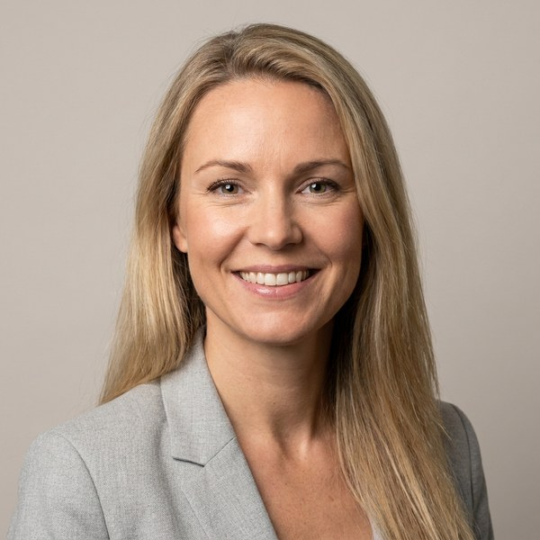
Candidate profile
Sofia Lindqvist
Strategy Director
Penhallow & Brice Group
A strategy and transformation director who has led the group's move into digital services.
Key experience
Education
Location
London, UK
Leads group strategy and the transformation office, reporting to the CEO
Designed and launched the digital services division, now £24m revenue
Eight years in strategy consulting before moving into industry
MSc Economics, Stockholm School of Economics
Recent roles
Strategy Director
Penhallow & Brice Group 2021 – Present
Principal
Hollins & Marr Consulting 2013 – 2021
Confidential · Template by Formatix.AI — formatix.ai/templates
‹#›

