Slide 1

Bid team presentation
Harbourside District Infrastructure Programme, Package 3
Proposed key personnel
Prepared for
Meridian Development Authority
Arcadia Engineering Partners
October 2026 · Confidential
Template by Formatix.AI — formatix.ai/templates

Slide 2

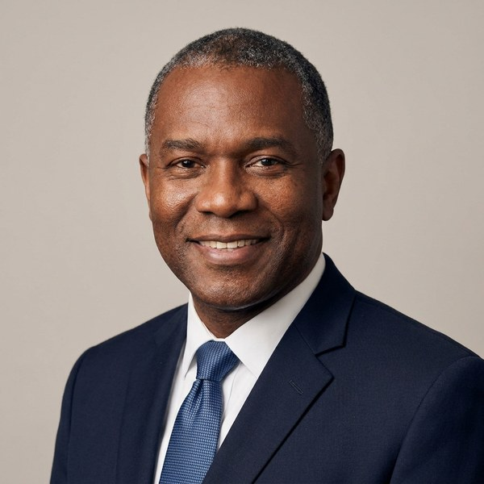
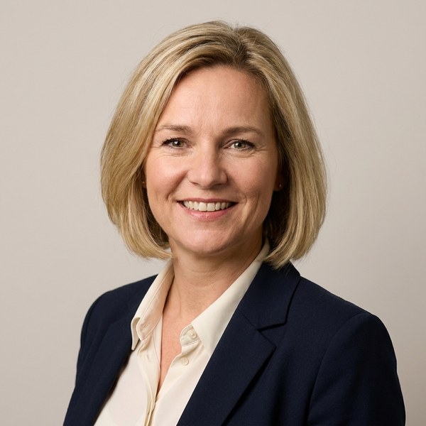
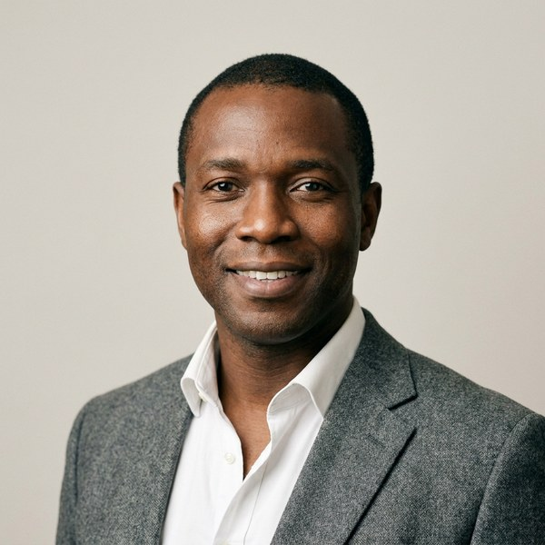
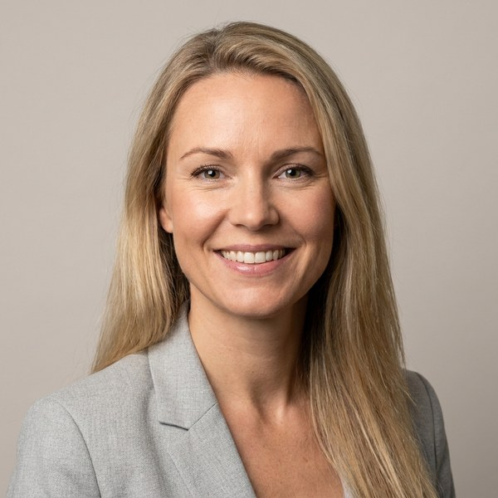
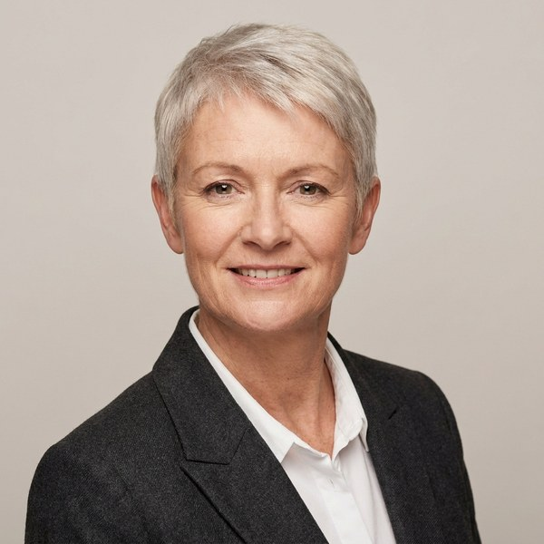
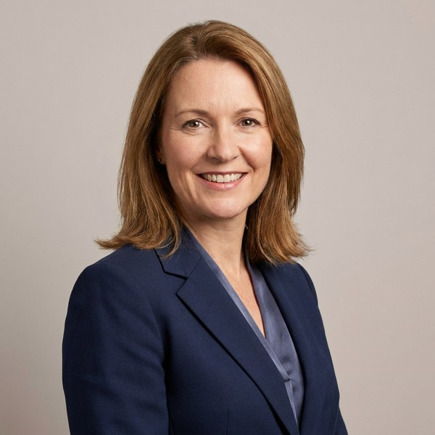
Harbourside District Infrastructure Programme, Package 3
Proposed team
The team we propose for this project
Daniel Okafor
Helena Vos
Marcus Oyelaran
Sofia Lindqvist
Alexandra Kerr
Hannah Whitcombe
Project Director / Team Leader
Resident Engineer
Senior Structural Engineer
Contracts & Commercial Manager
Urban Design & Landscape Lead
Health, Safety & Environment Manager
26 years · 14 in the GCC
19 years · 12 in the GCC
17 years · 7 in the GCC
15 years · 9 in the GCC
18 years · 6 in the GCC
13 years · 5 in the GCC
Experience as stated in each CV · Template by Formatix.AI — formatix.ai/templates
‹#›

Slide 3
Harbourside District Infrastructure Programme, Package 3
Proposed key personnel
Project Director / Team Leader
Daniel is a chartered civil engineer with 26 years in the design and delivery of urban infrastructure, 14 of them in the GCC.
Daniel Okafor
Programme & Project Management
Relevant project experience
Al Noor District Roads and Drainage, Package 2
Eastgate Public Works Authority · Doha, Qatar · QAR 2.1bn
Experience
Team Leader / Engineer’s Representative · 2021 – 2025
Led a 120-strong supervision team for 38 km of urban roads, 52 km of deep drainage and utilities diversions.
26 years · 14 in the GCC
Marina Quarter Infrastructure and Public Realm
Nationality
Coastline Development Company · Abu Dhabi, UAE · AED 940m
British
Project Director · 2017 – 2021
Directed design review and construction supervision of roads, cooling networks and landscaped public realm for a 1.8 km waterfront district.
Qualifications
Southern Ring Road Improvement Scheme
MSc Construction Management, University of Reading
BEng (Hons) Civil Engineering, University of Nottingham
Chartered Engineer (CEng), Engineering Council UK (2004)
Fellow, Institution of Civil Engineers (FICE)
Fenmore Roads & Transport Authority · United Kingdom · £186m
Senior Resident Engineer · 2006 – 2009
Supervised junction upgrades, structures and drainage on a live dual carriageway under NEC3.
Drawn from the CV submitted with this proposal · Template by Formatix.AI — formatix.ai/templates
‹#›

Slide 4
Harbourside District Infrastructure Programme, Package 3
Proposed key personnel
Resident Engineer
Helena is a highways engineer with 19 years in the supervision of urban road and interchange projects, including 12 years in Qatar and the UAE.
Helena Vos
Roads & Highways
Relevant project experience
North Corridor Expressway Interchange 7
Eastgate Public Works Authority · Doha, Qatar · QAR 1.4bn
Experience
Resident Engineer · 2020 – 2024
Led site supervision of a four-level interchange, 11 bridges and 9 km of approach roads.
19 years · 12 in the GCC
Airport Link Road Upgrade
Nationality
Coastline Development Company · Abu Dhabi, UAE · AED 610m
Dutch
Resident Engineer · 2016 – 2020
Supervised widening of 14 km of road to six lanes with utility relocations and night works.
Qualifications
A15 Maasvlakte Widening
MSc Civil Engineering (Transport & Planning), Delft University of Technology
BSc Civil Engineering, Delft University of Technology
Registered Professional Engineer, national engineers register (Qatar)
Member, Royal Netherlands Society of Engineers (KIVI)
Rijnmond Regional Roads Agency · Netherlands
Highway Engineer · 2009 – 2013
Pavement and drainage design checks and site quality inspections.
Drawn from the CV submitted with this proposal · Template by Formatix.AI — formatix.ai/templates
‹#›

Slide 5
Harbourside District Infrastructure Programme, Package 3
Proposed key personnel
Senior Structural Engineer
Marcus is a chartered structural engineer with 17 years in bridge, culvert and retaining-structure design and site supervision.
Marcus Oyelaran
Structures & Bridges
Relevant project experience
Al Noor District Roads and Drainage, Package 2
Eastgate Public Works Authority · Doha, Qatar · QAR 2.1bn
Experience
Structures Lead · 2022 – 2025
Reviewed the contractor’s designs for 6 bridges and 23 culverts; supervised deck pours and load tests.
17 years · 7 in the GCC
Creekside Pedestrian & Cycle Bridges
Nationality
Coastline Development Company · Dubai, UAE · AED 120m
British
Senior Bridge Engineer · 2019 – 2022
Design checks and site supervision of three steel footbridges over an operating canal.
Qualifications
MEng Structural Engineering, University of Bristol
Chartered Structural Engineer, Institution of Structural Engineers (CEng MIStructE, 2012)
Drawn from the CV submitted with this proposal · Template by Formatix.AI — formatix.ai/templates
‹#›

Slide 6
Harbourside District Infrastructure Programme, Package 3
Proposed key personnel
Contracts & Commercial Manager
Sofia is a chartered quantity surveyor with 15 years in contract administration and cost control.
Sofia Lindqvist
Quantity Surveying
Relevant project experience
Marina Quarter Infrastructure and Public Realm
Coastline Development Company · Abu Dhabi, UAE · AED 940m
Experience
Commercial Lead · 2017 – 2021
Valuations, variations and final account.
15 years · 9 in the GCC
Nationality
Swedish
Qualifications
MSc Quantity Surveying, University of Salford
Member, Royal Institution of Chartered Surveyors (MRICS)
Drawn from the CV submitted with this proposal · Template by Formatix.AI — formatix.ai/templates
‹#›

Slide 7
Harbourside District Infrastructure Programme, Package 3
Proposed key personnel
Urban Design & Landscape Lead
Alexandra is a chartered architect specialising in streetscape and public realm.
Alexandra Kerr
Architecture & Urban Design
Relevant project experience
Marina Quarter Infrastructure and Public Realm
Coastline Development Company · Abu Dhabi, UAE
Experience
Public Realm Lead · 2018 – 2021
Design review of the landscaped promenade.
18 years · 6 in the GCC
Nationality
British
Qualifications
MArch Architecture, University of Edinburgh
RIBA Chartered Architect; registered with ARB (2010)
Drawn from the CV submitted with this proposal · Template by Formatix.AI — formatix.ai/templates
‹#›

Slide 8
Harbourside District Infrastructure Programme, Package 3
Proposed key personnel
Health, Safety & Environment Manager
Hannah is a chartered safety practitioner with 13 years on infrastructure sites.
Hannah Whitcombe
HSE
Relevant project experience
North Corridor Expressway Interchange 7
Eastgate Public Works Authority · Doha, Qatar
Experience
HSE Manager · 2021 – 2024
Site HSE management for 1,400 workers.
13 years · 5 in the GCC
Nationality
Irish
Qualifications
BSc Environmental Science, University College Cork
Chartered Member, Institution of Occupational Safety and Health (CMIOSH)
Drawn from the CV submitted with this proposal · Template by Formatix.AI — formatix.ai/templates
‹#›

